Slide 1
AceEngineer Internal
Web Report Format
Development Plan
4th July 2016

Slide 2
Introduction
Web report should be such that
Display all text and tables
Display plots in interactive manner as much as possible
Display pictures/figures
Should have navigation bar on the left to easily navigate across the report with ease
Should be device independent (as much as possible). Clients may use tablets, desktops or phones (Windows, apple or android)
There may be templates already existing to develop the entire webpage with the design described in this section. Search/research online
D3JS or Python or PHP may already contain something similar that we can fork from?

Slide 3
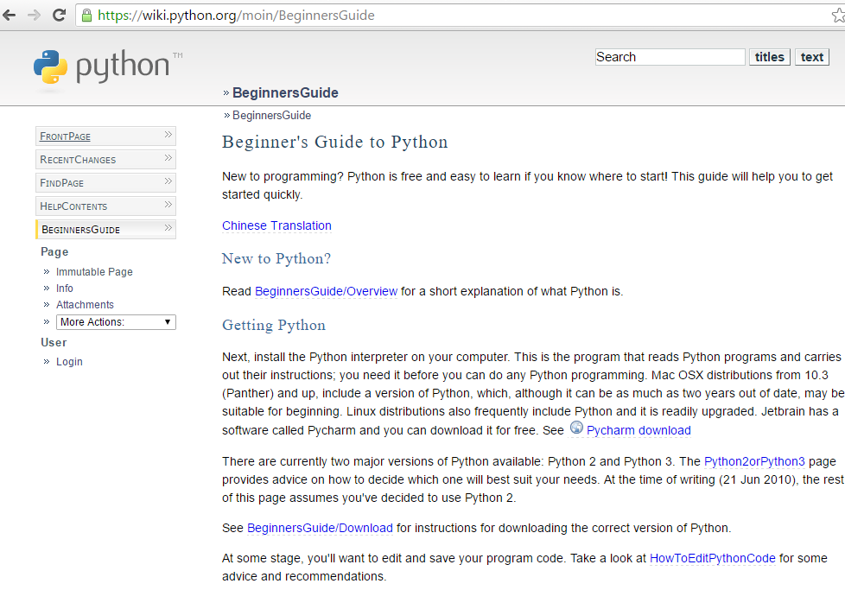
General Layout
URL
Content containing the following:
Headings
NVD3 Charts or other interactive charts
Pictures
Text
Navigation Pane

Slide 4
Navigation Pane
Navigation pane should be
URL driven
Clickable
Should have scrolling independent from main content page

Slide 5
Content
Content Should
Headings : 3 levels (3, 3.1, 3.1.2)
Based on heading definitions, the navigation pane should be automatically created. No need to program this again
Should support interactive charts, figures, tables etc.
Ability to click to expand figures and click to again unexpand
Etc.

Slide 6
Why Web Reports? – Current Process
Analysis Process Reporting Process
Calculations
10-15 files (5 revisions)
Excel
2-3 Engineers
Word
1-3 files (5 revisions)
Word
2-3 Engineers
Engineering Software Files
50-100 files (10 Revisions)
1-2 Engineers
PDF
1-3 files (5 revisions)
1-2 Engineers
Result Files
10-20 files
(5 Revisions)
Excel
2-3 Engineers

Slide 7
Web Report Process - Vision
Analysis Process Reporting Process
Calculations
10-15 files (5 revisions)
Excel
2-3 Engineers
Word
1-3 files (5 revisions)
Word
2-3 Engineers
Engineering Software Files
50-100 files (10 Revisions)
1-2 Engineers
.csv files
Web Report
1-3 files (5 revisions)
1-2 Engineers
Result Files
10-20 files
(5 Revisions)
Excel
2-3 Engineers
Standardization of processes
Easy updates with programming/automation
Enhanced features using web reports

Slide 8
Presentation Title
01 | New document | 20 January 2016 |  | V Achanta | - | -
Rev | Description | Date |  | Author | Checked | Approved
Document No: 0119-PRS-0001 |  |  | Client Ref:
 |  |  | -

Slide 9
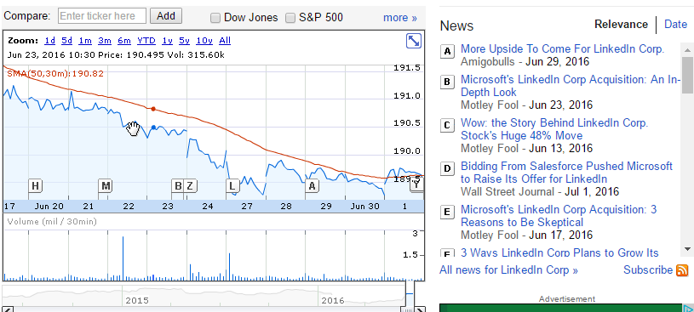
Chart Capabilities - Vision
Ability to add notes to chart to show significant events
Have the ability to make notes visible or invisible based on user interaction
Google finance design of events on stock chart is a very good start (see notes on right and labels on chart)

